Slide 1








Empower Smart Enterprise
Home Solutions Products Our Customers Contact us Download PDF
OK
Introducing All New
Dynamic and Movable Learning
Develop, Engage, Track Results with mobile blended learning platform
Redefining Enterprise Training and HR Development with Mobile First Learning solution
making it Faster, Easier, and Smarter Anywhere, Anytime.
Learn more
Request for Demo

Slide 2
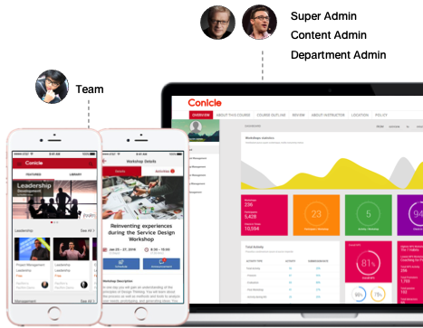




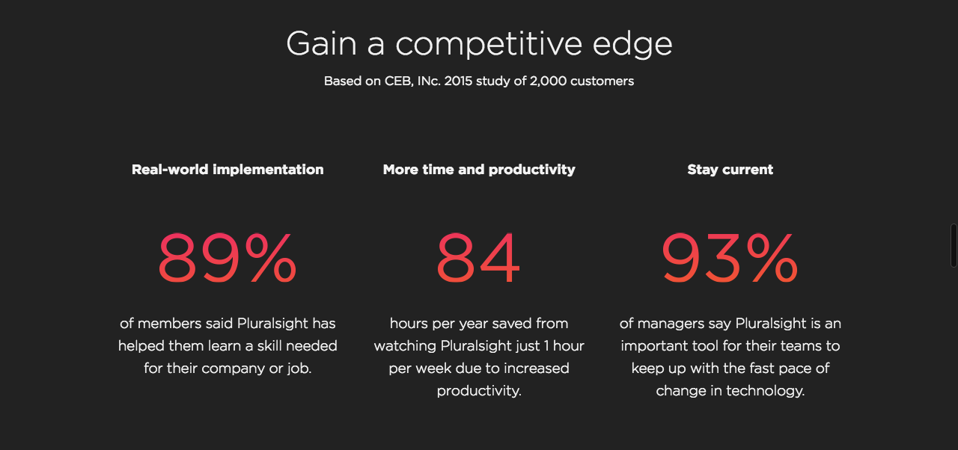
Mobile First for Team Development.
Empowering your team & organization with all-in-one mobile learning platform
to learn and connect faster, easier, and smarter anywhere anytime.
OK
Mobile Learning. Anywhere Anytime.
Using cloud-based ondemand training platform to learn anywhere anytime on web and mobile app with friendly experience.
Blended Learning. Smart, Fast & Easy.
Learning with VDO, audio, doc, live class, and test form and two-way communication tools such as discussion board, survey and questionnaire.
Personalized Learning Path
Creating and assigning content playlists to promote individualized learning paths to match the required skills of each position and career path.
Result Tracking and Data Analytics
Tracking the progress and seeing the reports to measure and analyze adoption, achievement, time that users spend learning and testing results.

Slide 3
Mobile Learning breaking the barrier
As mobile is transforming how we live and work, Conicle builds a revolutionary mobile learning platform
to empower your team ever better and be part of your brighter future workplace.
OK
Mobile Learning to retain and develop Talent
More Achievement &
Better Engagement
Mobile device is the most critical work device
89%
3x
65%
of employees say “If my employer invests in my training, I’m more likely to stay at the company long term.”
Users studying on mobile devices are 3 times more likely to track their progress and get achievement.
of workers declared their mobile devices to be their “most critical work device.” since 2012
Source : elearningindustry.com

Slide 4
Better HR Development with Blended Learning Platform
Leverage the capabilities of online media and offline activities to benefit Team Development
Onboarding Program
Developing team at the very first step with blended learning solution
ONDEMAND
& LIVE
Internal Communication
OK
Communicating and connecting to a person or the whole team faster, easier and smarter
CONNECT
Online-to-Offline
Personal Learning Path
Personalized Program to fit with each position and career path
Event / Workshop Management
Attending company’s Event / Workshop better ever with online process to enhance offline activities
Knowledge Management
Learning and sharing anywhere anytime with Organization’s Mobile KM
Survey and Questionnaire
Getting feedback from customer and team quick and easy with simple process and analytical report
The innovative solution that enhancing HR process to be a faster and smarter enterprise with
Team Development . Knowledge Management . Internal Communication
Less Complicated
Faster and Smarter
More Engaged
It’s BYOD
Easy and Good Experienced
with end-to-end platform
Anywhere Anytime
Bring your own device
Full platform for the best performance : Mobile + Cloud + Data + APIs : aligned with your business process to achieve your business objectives

Slide 5





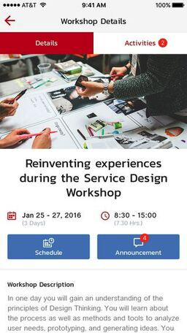
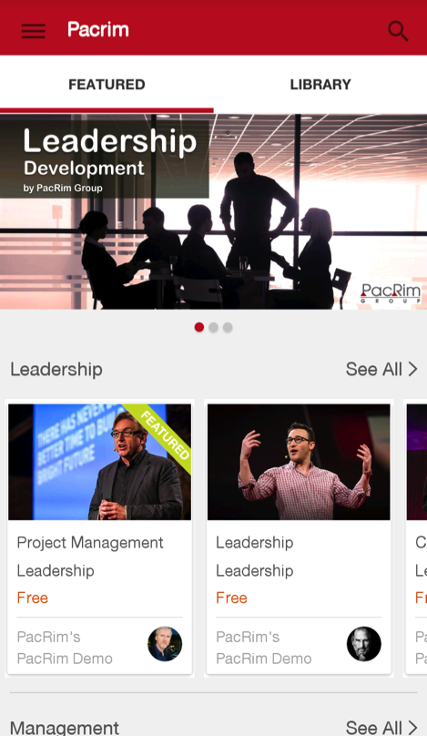


OK
All-in-One Mobile Learning Anywhere Anytime
Develop people anywhere, anytime via web and mobile with Ondemand Courses, Live Class and Interactive Test and also analytical data and report. It’s all you need to develop your team on-the-go faster, easier and smarter.
Knowledge & Course Center
Ondemand Course with VDO, Audio, Doc
Interactive Test with Score & Result
Programs, the learning playlist
Self-Register or Assignment
Progress Tracking
Upcoming Live Schedule
Live Class Broadcasting
Ondemand Re-run Live
Discussion Board Q&A
All Content Management
Dashboard, Analytics and Report
Self Learning Path
From onboarding program to everyday learning, Conicle platform providers on-the-go learning experience for each position and career path.
KM System
Organization’s Mobile KM platform to let team, customers, and company’s partners learn, share and grow anywhere anytime.
Internal Commu
With Mobile device on everyone’s hand, your company can communicate and collaborate to a person or the whole team faster, easier and smarter.

Slide 6

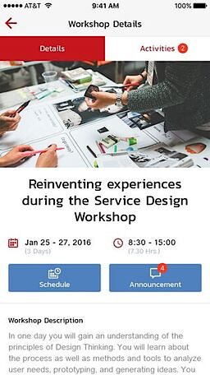

OK
Enhance Offline activities with Online Capabilities
Process corporate’s event and workshop ever better and faster with online features such as online register, check-in, pre-work and post-work, evaluation. It’s working with online learning platform to synergize team learning process with seamless experience.
All upcoming events to attend
Event details, schedule & location
Self-Register or Assignment
Pre Test, In-class Test, Post Test
Check-in by agenda
Announcement & Notification
Discussion Board Q&A
Evaluation, Survey, Questionnaire
All Content Management
Dashboard, Analytics and Report
WORKSHOP
Reduce operation process and time with mobile capabilities ; online register, check-in, online test, etc. Making workshop more effective and better experienced.
CORP EVENT
Arrange and run company’s event more effectively with mobile platform to reduce time and cost, and provide an elegance experience to all your team.
SURVEY
Get feedback and analytical data from team, customers and business partners quick and easy with smart but simple mobile process.

Slide 7


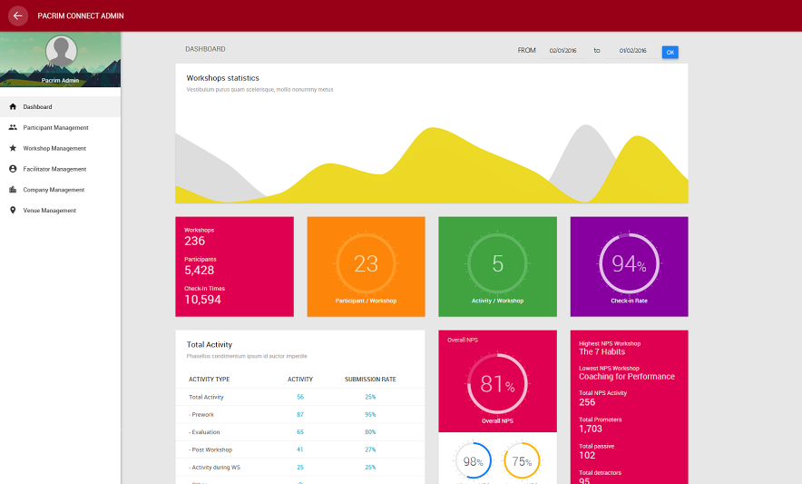
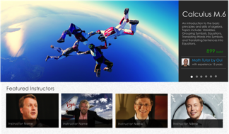
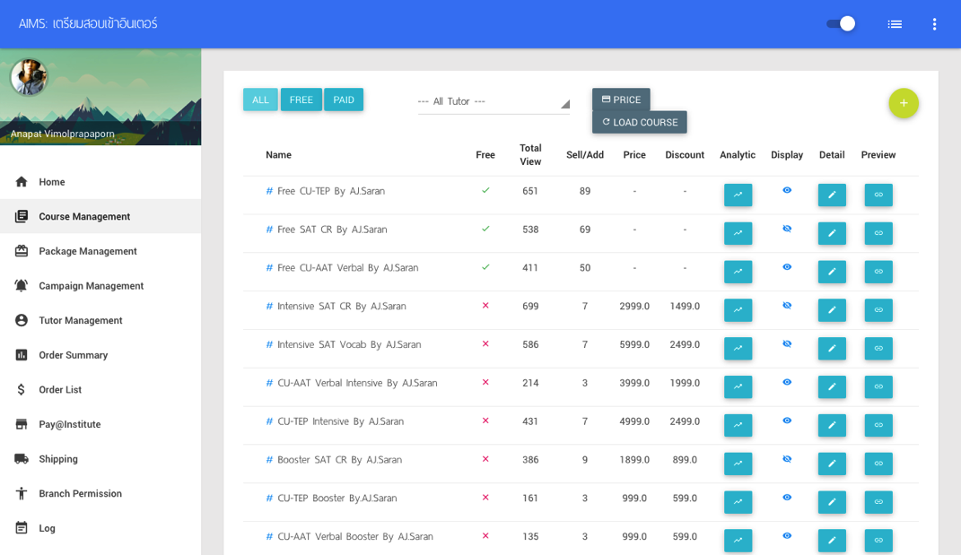
All-in-One Administration System
Manage, control and analyze in one place with multi-level management
OK
User Account Management
Content & Media Management
Assignment, Progress & Report
User (Learner) Management
Department (Group) Management
Admin Account Management
Admin Authority Management
Content Provider Management
Content Management
Learning Material Management
Course, Test, Program, Live Class
Event / Workshop Management
Survey Management
Assignment Management
Alert & Notification Management
Self Registration Report
Learning Progress Tracking
Dashboard & Analytics

Slide 8



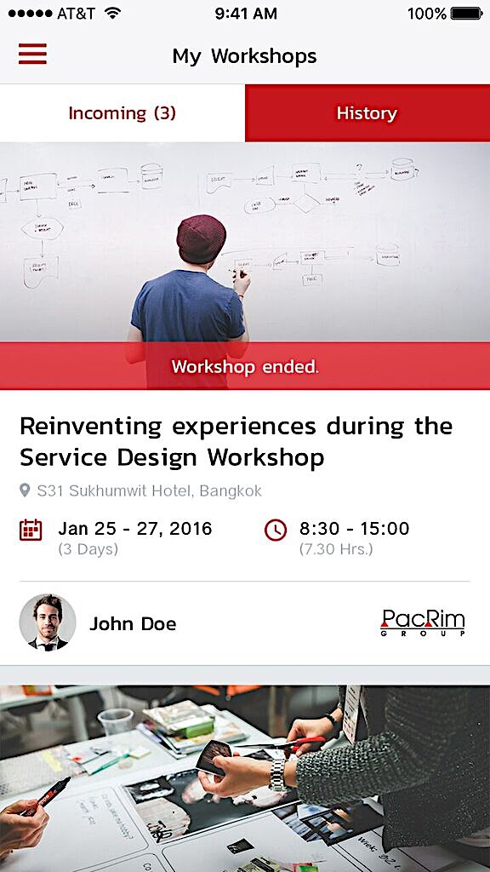




Learners
Access to learn with Blended Learning Platforms on Web/Mobile
Conicle CONNECT
Connecting Online-to-Offline platform helping learners to attend, learn, interact, and measure in workshop activities
OK
Conicle ONDEMAND
Assign/Register
Pre-work
Check-in
Interact
Post-work
Result
Ondemand Learning with VDOs, Course, Test, Program in personal learning path anywhere anytime
Assign/Register
Learning
Testing
Progress
Result
Blended Learning Solution
Manage
Conicle LIVE
Data & Tracking
Real-time broadcasting class, event and workshop to learners anywhere with interactive communication.
Administrator
Schedule
Notification
Broadcasting
Re-run
Result
Managers
Manage, control and analyze in one place with multi-level management

Slide 9


We serve Enterprises across the industries.
OK
All-in-One AIS HR development platform
Implementing all Conicle learning platforms; ONDEMAND and CONNECT, to develop and grow all teams in the company from AIS HQ to all departments and branches all around the country.
AIS or Advanced Info Service Public Co., Ltd. is Thailand's largest mobile phone operator with more than 40 million subscribers providing full length of digital products and services.

Slide 10

We serve Enterprises across the industries.
OK
Workshop On-the-Go
Applying Conicle ONDEMAND and LIVE to broadcast company’s workshop to business partners around the country via web and mobile device anywhere anytime.
Unilever is one of the world's largest consumer goods company. Its products include food, beverages, cleaning agents and personal care products and more.

Slide 11

We serve Enterprises across the industries.
OK
The Hybrid Learning
Utilizing the capabilities of Conicle ONDEMAND to enhance learning experience by combining offline workshop with online self-learning
PacRim Group is a leading HR consulting partner of organizations providing new services to match the dynamic & fast-changing needs for leadership development and growth.

Slide 12
We serve Enterprises across the industries.
OK
Tutors on your hand
Using Conicle ONDEMAND to be ClickforClever’s online course marketplace integrated with payment system to sell and provide online courses directly to their customers.
ClickforClever.com is one of the most popular online tutoring website among high school students in Thailand providing variety of courses with the concept “Online Edutainment”.

Slide 13

Download PDF
Request for Demo
OK
At Conicle all we do is to empower your team to be successful.
Conicle builds revolutionary business solutions, served from mobile & cloud, created to help you grow and develop your team faster and smarter by experiencing and engaging them much better. By leveraging the capabilities of the emerging technologies, Conicle make innovative solution which is compatible with your business process and strategy to achieve your business mission and goals.
Let’s build the better future with us
Request for Demo and Quotation
Your name
Company name
Email
Nakorn Phuekphiphatmet
Email : nakorn@conicle.com
Mobile : +66877975636
Conicle Co., Ltd.
33 Pradipat 17, Samsennai,
Phayathai, Bangkok, 10400
Thailand
Message
Submit
Technology enabled. Everything’s possible.
Copyright 2016 Conicle Co., Ltd.

